Slide 1
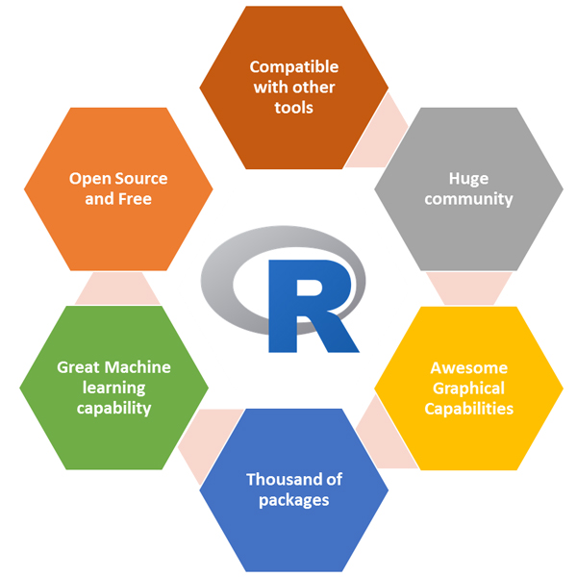
R Training: Day 1

Slide 2
Introductions
Instructor: Kasun Samarsinghe
Sr. Data Scientist, Device Authentication and Identification, American Express
Background: Security in Fintech and e-Commerce
Hobbies: Biking and Hiking

Slide 3

R Basics
What Is Arghhh? Or R Or Whatever It Is
Statistical Coding Language
Open Source
Powered By Packages (Which We Will Get Into Shortly)
When Do I Use R??
Data Cleanup
Data Joins
Statistical Testing
Data Visualization (See Below)
Machine Learning
Anything Else?? (Cases Where You Can Use R, But There Are Probably Better Tools)
Website Design
Website Creation (R Shiny)
Data Visualization For Executives

Slide 4
R Basics
I’m Afraid Of Coding, Why Should I Trust You That This Will Be Easy?
Math Operations Are Familiar (+,-,*,/)
Most “Calls” Are 1 Line Of Code, Especially Machine Learning
Packages Are Named Intuitively
Data Is Structured In Data Frames, Which Are Similar To Your Experience To Excel

Slide 5
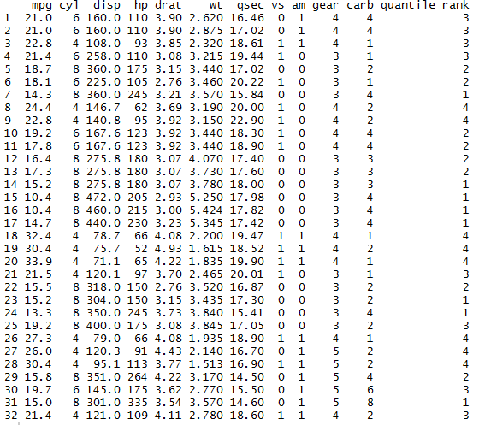
R Basics
I’m Almost Convinced, But What Is A Data Frame?
A data frame is a type of object that is suitable for holding a dataset that is composed of vectors of the same length displayed side by side
Or

Slide 6
R Terminology
There Are 3 Main Vocab Words That Will Be New To You For R
R Studio
Data Frames (Which We Just Covered)
Objects

Slide 7
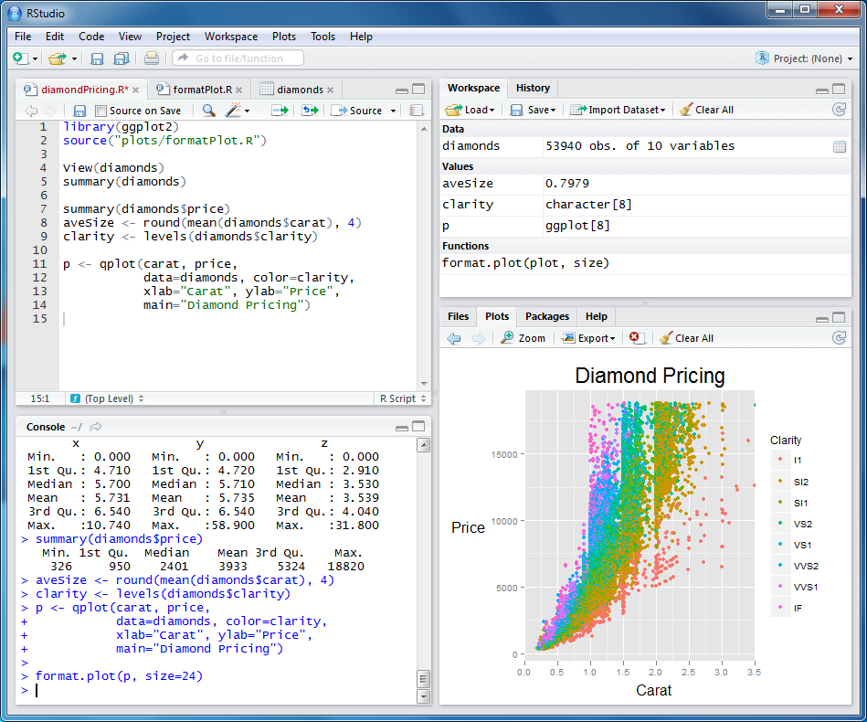
R Terminology
R Studio
Where We Will Be Doing Our Work
- You Don’t Need To Use R Studio, You Can Use R But This Gives A Nice Clean Interface To Work With

Slide 8
R Terminology
Objects
Objects are slices of data that we have given a name and stored in memory.
Examples:
Your Initial Data Set
A Subset Of Data That You Filtered Out
Regression Model
Allows You To Easily Subset Data. You Build An Object By Doing The Following:
New_Object <- Var1+Var2

Slide 9
R Terminology
Calling Variables
This Is An Exception Because For Most Packages, This Does Not Apply But If You Want To…
Quickly Do A Calculation
Find The Average Of A Variable
Find An Exact Value In A Column
You Will Need To Call A Variable By Doing The Following:
Object$Variable
Example: I Want To Find The Mean Of The Variable, Dollars_Spent In The Object Bank
Mean(Bank$Dollars_Spent)

Slide 10
R Packages
Makes Our Life Much, Much Easier
Simplistic Functions That Have Been Created, So You Can Do Your Job Faster & Easier
Dplyr – Data Manipulation
Ggplot2 - Visualization
Packages Can Be Tricky To Set Up, But Follow This 2 Step Process
Call install.packages(“place_package_here”) and hit enter.
After that installs, call library(place_package_here) and hit enter.
Ready To Use

Slide 11
R Packages
Dplyr – Most Commonly Used Package In R
We Can Use This To Easily Do The Following Tasks:
Select
Filter
Rename
Create
Summarize
Join
* Also we can use data.table library for data manipulation
Essentially All Of Our Data Cleansing Tasks
Cheat Sheet: https://www.rstudio.com/wp-content/uploads/2015/02/data-wrangling-cheatsheet.pdf

Slide 12
Loading Data Into R
Two Ways:
File -> Import Data Set
read. Function
File -> Import Data Set
What We Will Mostly Use In Training
Limited To Data Sets (Text, Excel, SAS, Stata SPSS)
read.function – Can Do All Of The Following And…
SQL
ODBC
Oracle
https://www.datacamp.com/community/tutorials/importing-data-r-part-two
Practice:
Load In Today’s Data Set Mass_Mutual_Day_1 into R.
Rename Mass_Mutual_Day_1 to something else.

Slide 13
Review Data
There Are Two Functions We Can Use To Review Our Data
summary()
glimpse()
What Is The Difference Between The 2
Summary -> Tells Us Our 6 Key Statistics: Min, Median, Mode, Max, Quartile Range.
Also Tells Us How Much Of The Data Is Missing
Glimpse -> Tells Us All The Values & Type Of Variable (number, string, date)
Different Purposes But Gives Us Initial Insights
Practice:
Apply Summary & Glimpse to the data set and be ready to talk about initial observations.

Slide 14
Data Cleansing
Most Crucial Step In Any Data Problem!
Reporting
Prescriptive
Predictive
Garbage In Means Garbage Out
There Are Best Methods To Handling Bad Data, Especially For These 3 Scenarios
Data Types
Missing Values
Anomalies

Slide 15
Data Cleansing: Data Types
Not Always Easy To Correctly Identify How Data Should Be Classified
Example:
5 - How Could The Number Be Classified
2018-01-05 – How Could This Be Classified
Why Is This Important??
Need To Know If There Is Supposed To Be A Relationship
Is It The Actual Value Or Representation
Models Need Correct Data Types
We Can Use These Three Functions To Help With This Problem
As.character -> df$Var1<-as.character(df$var1)
As.Number
As.Date
This Will Create The Updated Variable, We Will Learn Later How To Put In Into The Data Frame
Practice:
Convert Insurance_Type Into A String

Slide 16
Data Cleansing: Missing Values
This Is One Of The Harder Data Cleanup Elements To Handle
Is It Supposed To Be…
0
Blank
Some Other Value
What Do We Do With The Value
Get Rid of The Data Point
Make It A Zero
Make It The Mean/Median Value of The Column
Gets Even Tougher If It Is A String.
Practice:
Which Columns Do We Need To Fix Due To The Above Issue & How Would You Approach It?

Slide 17
Data Cleansing: Missing Values
Issue With <=10% of Data
Two Situations:
Remove Values – If So Little Is Missing Then We Don’t Need To Clutter With Bad Data
Replace With Mean/Median – Fills In Missing Values & Keeps Distribution Integrity
Issues With >=10% and <=45%
Two Situations:
Replace With Mean/Median – Fills In Missing Values & Keeps Distribution Integrity
Replace With Value – Could Be 0 or Some Business Value That Makes Sense
Issues With >45% of Data
Two Situations:
Replace With Value – Could Be 0 or Some Business Value That Makes Sense
Remove Column From Analysis
Practice:
Now, How Would You Clean Up Each Variable? We Will Actually Clean Them Up Later.

Slide 18
Data Cleansing: Anomalies
Otherwise Known As Outliers, But We Need To Be On The Look Out For:
High Values
Low Values
Don’t Overthink Your Strategy:
+- Two Standard Deviations
If It Is Slightly Above Or Below, Use Data Visualization To See How Non Normal Value It Is
If You Want To Improve This Method:
Group Data Together & Look For Outliers Within Groups, Not Just The Total
Example
Looking At Deposits From 1000 Banks That Range From Credit Unions To MNC
Group Different Sizes Of Banks To Spot Outliers In Deposits, Not Just The Total Spectrum
Additional Research, Easy Work, Better Results.
Practice:
We Want To Look For Outliers In The Column, Savings, Later On Today. What Should Our Outlier Values Be? Hint: Mean & sd (standard deviation) functions will help

Slide 19
Manipulating Data: Business Rules
Now That We Looked At Best Data Cleansing Practices, We Can Apply Them
Selecting The Data That We Want To Work With, You May Want To:
Drop Columns
Rename Data
Filter Data
Distinct Data
Using Dplyr We Can Do All Of These Tasks Using The Following Calls:
Make Sure To Create A New Object For Each Manipulation
Select – This Will Allow Us To Choose Which Columns We Want Or Don’t
Select Certain Columns: select(df,column1,column2)
Select All Columns: select(df,everything())
Drop Columns: select(df,-column4,-column5)
Rename – This Will Allow You To….Rename
Rename(df,new_name=old_name)
Filter – This Will Allow You To …. Filter
Filter(df,column1>7)
Filter(df, is.na(column1))
Distinct – Distinct(row)

Slide 20
Manipulating Data: Business Rules
Business Practice– Part 1
Create A New Object Called, Results, That Includes All Columns Except Date & Previous_Plan
In The Object, Results, Rename The Column, Insurance_Type to Type
Filter Out Results In The Column, Savings, That Are Higher Than Mean + 2 STD
Create Separate Objects For Columns With Missing Values

Slide 21
Manipulating Data: Business Rules – Part 2
Now That We Know What We Want To Clean Or Update, How Do We Do That??
Business Rule Formulas
Comparison Formulas
Formulas: Use The Call “mutate”
Create New Variables
Mutate(df,new_var=var1+var2)
Filter & Replace
Want To Replace Nulls With A Value
Subset The Data
Change Missing Values To The New Value
Union Back
Union(df1,df2)
3. Conditionals
We Will Not Use Mutate, But Just A Simple If Else With &
df$new_var=ifelse(condition1&condition2, yes,no)
4. Joins
All Similar To SQL (Inner, Full, Right & Left)
Object<-left_join(object1,object2, by= “var1”

Slide 22
Manipulating Data: Business Rules
Business Practice– Part 2
Union The Old & New Objects So That We Have A Data Set With No Missing Values
Create A Variable Called, Savings_Per_Year, Which Is Savings/Age, In The Object Results
Create A Variable For Auto_Accept, Which Is When Savings > 500000 & Married = 0

Slide 23
Manipulating Data: Summarize
Data Analysis On The Fly - The Need For Pivot Tables
We Can Easily:
Summarize 1 Column
Summarize All Columns
Group By
Summarize 1 Column:
Summarise(df,avg=mean(column)) -> Remember No Nulls Since This Is For The Average
Summarize All Columns:
Summarise_each(df,list(mean))-> Remember No Nulls Since This Finds The Average Of All Columns
Group By:
Group_by(df,var1,var2)
Aggregate:
Object_new<-group_by(df,var1,var2)
summarise(Object_new, new_var=mean(var), count=n())

Slide 24
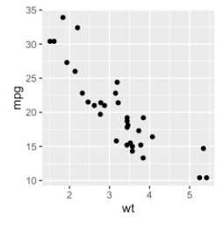
ggplot
Visualization In R (Or At Least The Easiest Way To)
This Is Not Going To Replace Tableau For You
Why Use It Then??
Data Discovery
Data Cleanup
Easy & Convenient

Slide 25
Line Chart
Look At Trending Information
One Line Of Code:
Ggplot()+geom_line(data=df,aes(y=var1,x=var2))
Practice:
Plot Time On The X-Axis & Risk Score On The Y-Axis

Slide 26
Bar Chart
Look At Distributions
One Line Of Code:
Ggplot (data=df,aes(y=var1,x=var2))+geom_bar
Practice:
Plot Gender On The X-Axis & Savings On The Y-Axis
Extra Credit, Look At Avg Savings

Slide 27
Scatter Plot
One Of The Most Effective Ways To Find Outliers: Scatter Plot
Three Basic Components:
X-Axis
Y-Axis
Shape
Sample Code: ggplot(data=df,aes(x=var1,y=var2)) + geom_point()
Practice:
Plot Age Vs. Savings & See If There Is A Relationship There
Would We Expect A Correlation?
Do We See Any Correlation?

